Slide 1


Group 27 BETTer Project
By Franco, Pruthvi, Anas, Anthony, Romi, Camron, Felipe

Slide 2
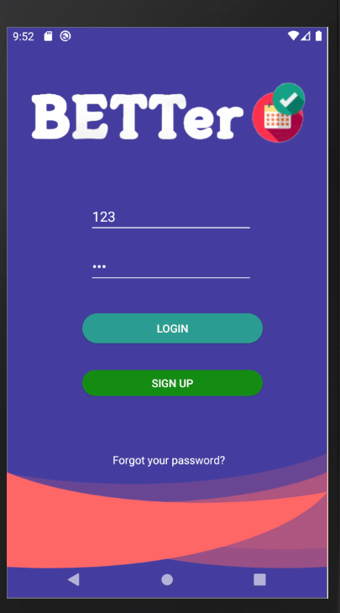
The Project
BETTer (Better Easier Time Table)
Easy and quick timetable access
Notifications for lectures and labs
Map of the university campus
Lab Selection and storage
A quick and easy login function
A regularly maintained and easily updatable database

Slide 3
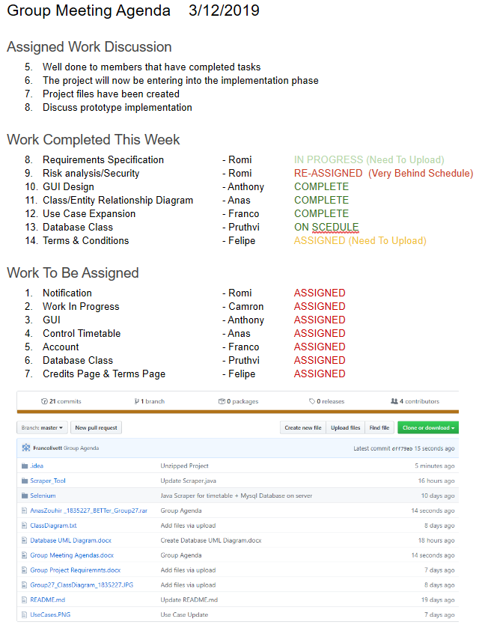
Plan Manage And Track
LO: 1
We have used GitHub to track our group project and organise all of the projects assets and planning material.
We assigned a project manager (Franco) to organise our twice weekly group meetings and assign tasks to members of the group.
We created a meeting agenda and notes for each week of the project to track what we have done and any new assigned tasks for that week.

Slide 4
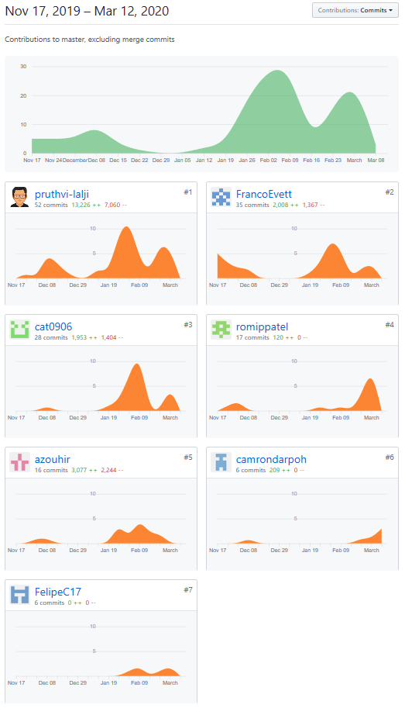
GitHub
LO: 1
We have used GitHub to track most of our progress and track contribution to the documentation and code. To the right is a contribution graph over the duration of the project.

Slide 5
Collect and Analyse Project Requirements
LO: 2
First we found the area for our problem (Timetable too slow to access)
Then we analysed the current problems
We then conducted a survey and interviews to collects desired features
Then we refined the requirements and designed a GUI prototype
Next we began to entered the design phase

Slide 6
Design Development and Testing
LO: 3
Must be non trivial
Design processes
Systematic testing
We have fulfilled these requirements with our well thought out design process and our systematic approach to the project (Weekly Scrum Meetings and Sprints). WE have sampled our applicated to a large number of student and they have all said they would use this in there daily university life.

Slide 7
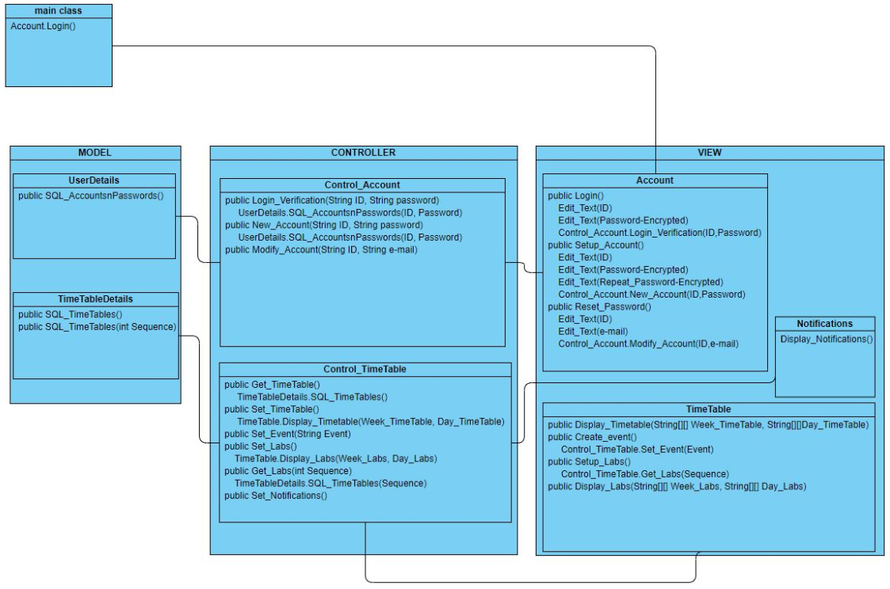
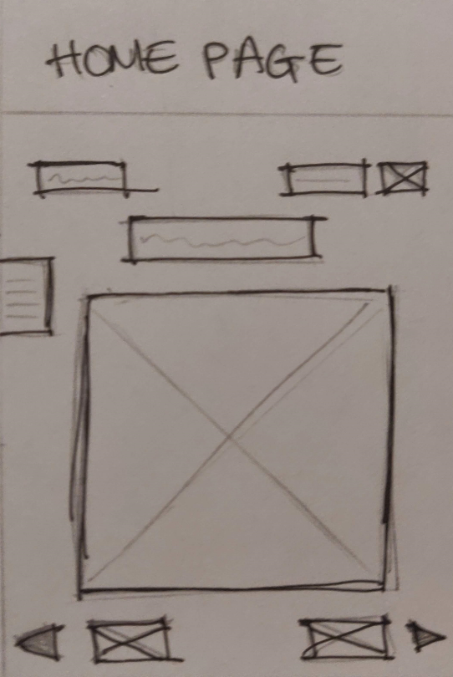
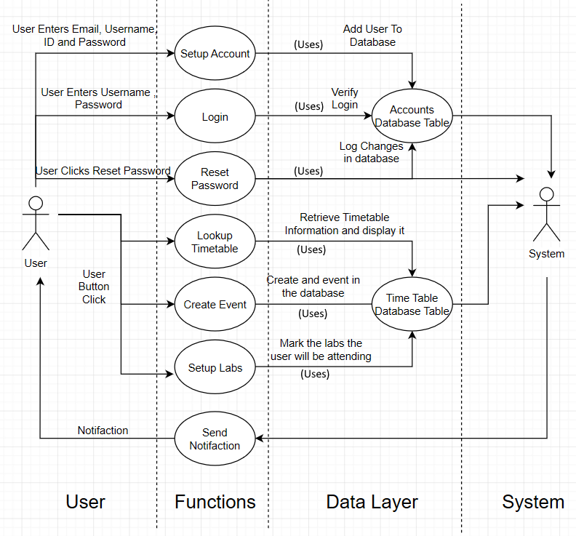
Design
LO: 3
Once we had collected the user requirements we be began to develop a basic drawn designs, Use Cases, Class Diagrams and Sketches.
We also have more recourses on GitHub such as the logical model and more sketch designes.

Slide 8
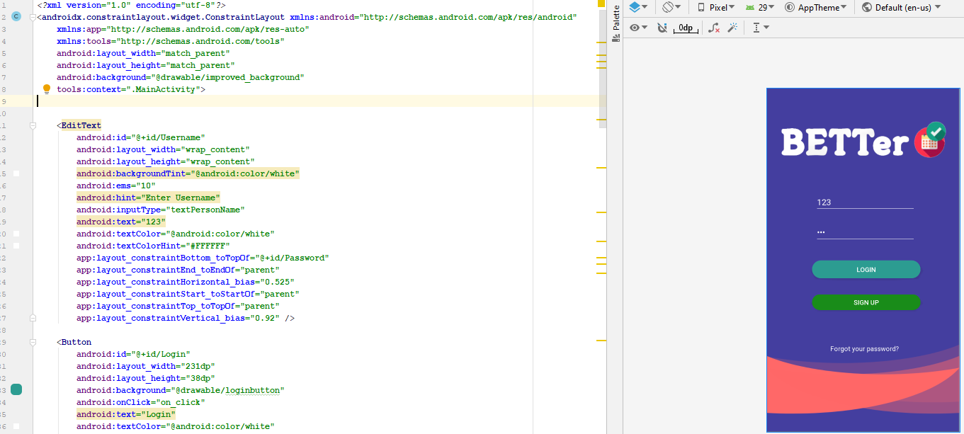
Development
LO: 3
Once we had designed the basics of how we wanted our app to look and work we began creating the first iteration. Then each week the project manager would create a list of tasks that were done last week and a new list of tasks for this week (Sprints)

Slide 9
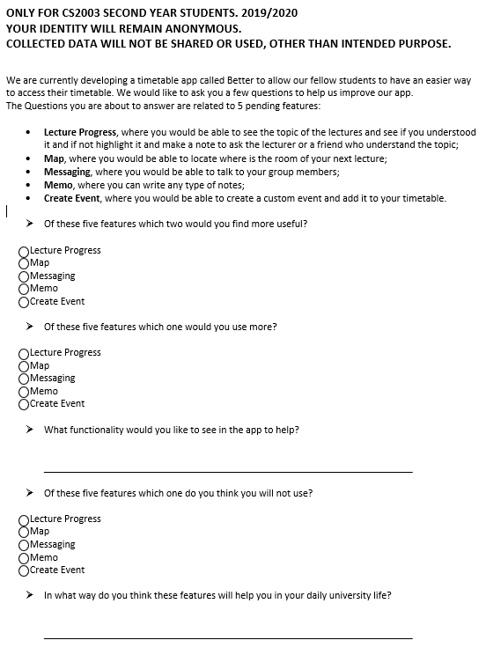
Testing
LO: 3
We made use of a questionnaire and interview testing to evaluate and improve our app. We contacted other CS2001 groups and had them look at our app and evaluate it out load as they were using it. Then we had them fill out the questionnaire to the right.

Slide 10
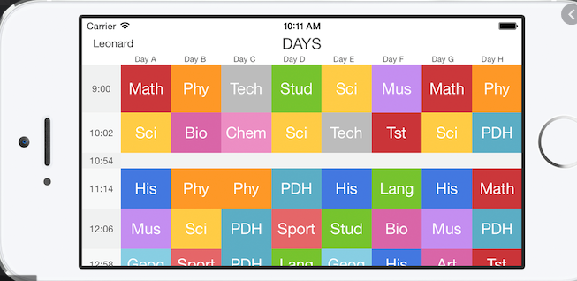
Evaluate Alternative Solution To The Problem
LO: 4
Look at other university timetable apps
Evaluate there usability compared to our own
Compare features and see where we could improve our design
Compare security and data required

Slide 11
Communication & Presentation Of Our Ideas
LO: 5
Twice Weekly Group meetings
Once Weekly Tutor Meetings
Use Discord and WhatsApp for communication
Participated in and Won made in Brunel Academic Section

Slide 12
Profession & Ethical Behaviour
LO: 6
We have conducted professional and productive meetings each week and made sure to adhere to any scheduled meetings we or the university have dictated. We have also responsible tracked and managed each group members contribution to the project and will not mis represent what we have completed. We have adhered to the design process and are not deconstructing a finished app to create a design process.

Slide 13
Reflecting On Experience learned
LO: 7
From this project we have learned how tight larger scale projects can be and how difficult it is sometimes to complete a list of tasks given is a reasonable time. Mush of this came from balancing multiple project and course work takes with lecture and the main group project. We have realised the importance of organisation and meetings as well as the design process. We conducted a full analysis and design process enabling us to finish a with a higher class product that we would have otherwise. Overall we are happy with the project we have created and many of the group members are already using it in day to day life.

Slide 14
Franco Evett - Contributions
Group Manager
Planned Meeting and Took Meeting Notes
Designed the Uses cases for the system
Coded the login class
Coded Password Encryption/Decryption
Helped Design the login table for the database

Slide 15
Romi Patel- Contributions
Writing user requirements
Coded Notification Feature of the app.

Slide 16
Pruthvi Lalji - Contributions
Created database of the app
Scraped data for the database
Design the Database UML Diagram
Database created for storing timetables info and user info
Coded implementation of database (timetable and user login)
Designed leaflet for marketing
Testing of the App
App suggestion were made

Slide 17
Anas Zouhir - Contributions
Created Front End of the App
Designed Class Diagram for the system
Coded the home page class (display timetable)
Coded Map feature of the app
Currently working on local database (Shared Preferences)

Slide 18
Felipe Cardoso - Contributions
Terms and Conditions for the app
Questionnaire for the extra features
Tried to do forgotten password

Slide 19
Camron Darpoh- Contributions
Wrote risk analysis for the project
Implemented terms of service & privacy policy on app
Added code to make sure users agree to terms before creating an account

Slide 20
(Anthony) Tzu-LunYeh - Contributions
Created Front End of the App
Designed the GUI
Tested the Login function
Testing of the App

